Slide 1
Department of Computer Science & Engineering
SUBJECT: DESIGN AND ANALYSIS OF ALGORITHMS
SUBJECT CODE: 19PC1CS03
TOPIC NAME: INTRODUCTION TO ALGORITHMS
YEAR: II-YEAR SEC: C
Vallurupalli Nageswara Rao Vignana Jyothi Institute of Engineering &Technology
Dr. P Neelakantan
Professor
Email: neelakantan_p@vnrvjiet.in

Slide 2
Agenda
Characteristics of algorithm
Analysis of algorithms:
      Asymptotic analysis of complexity bounds – best, average and worst-case behavior
Performance measurements of Algorithm, Time and space trade-offs.
Divide and conquer General method,
applications-Binary search,
Quick sort,
Merge sort,
Strassen ‘s matrix multiplication.
Analysis of recursive algorithms through recurrence relations:
  Substitution method,
  Recursion tree method and Masters’ theorem.

Slide 3
Algorithm
An algorithm is a finite set of instructions that accomplishes a particular task. An algorithm must satisfy the following criteria
Input: zero or more quantities are externally supplied
Output: At least one quantity is produced
Definiteness: Each instruction is clear and unambiguous
Finiteness: If instructions of an algorithm is traced then the algorithm terminates after a finite number of steps
Effectiveness: Every instruction must be very basic.
An algorithm is composed of a finite set of steps, each of which may require one or more operations. The possibility of a computer carrying out these operations necessitates that certain constraints be placed on the types of operations an algorithm can include.

Slide 4
Algorithm
The study of algorithms include four distinct areas of study
How to devise algorithms: Creating algorithm may never be fully automated. Study of various design techniques proven to be useful in yielding good algorithms.
How to validate algorithms: Once an algorithm is devised , it is necessary to show that it computes the correct answer for all possible legal inputs and this process is known as algorithm validation.
How to analyze algorithms: As an algorithm is executed, it uses the computers central processing unit to perform operations and its memory (both immediate and auxiliary) to hold the program and data. Analysis of algorithms or performance analysis refers to the task of determining how much com­puting time and storage an algorithm requires. This is a challenging area which sometimes requires great mathematical skill.

Slide 5
Algorithm
How to test a program - Testing a program consists of two phases: debugging and profiling (or performance measurement).
Debugging is the process of executing programs on sample data sets to determine whether faulty results occur and, if so, to correct them. In cases in which we cannot verify the correct ness of output on sample data, the following strategy can be employed: let more than one programmer develop programs for the same problem, and compare the outputs produced by these programs.
If the outputs match, then there is a good chance that they are correct. A proof of correctness is much more valuable than a thousand tests (if that proof is correct), since it guarantees that the program will work correctly for all possible inputs.
Profiling or performance measurement is the process of executing a correct program on data sets and measuring the time and space it takes to compute the results.

Slide 6
Difference between Algorithm, Pseudocode and Program
Algorithm
An algorithm is a step-by-step procedure to solve a problem. A procedure is a finite sequence of instructions, where each is carried out in a finite amount of time. Every problem can be solved with the help of an algorithm.
Algorithm for linear search
  Start searching for an element from the left-most part of the array.
  Compare one element every iteration with the item_to_be_searched.
  If no matches are found, return -1.
  Otherwise, return the index at which the element is present.
Pseudocode
Pseudocode is an informal way of writing a program. It is not exactly a computer program. It represents the algorithm of the program in natural language and mathematical notations. Usually, there is no particular code syntax to write a pseudocode. Therefore, there is no strict syntax as a usual programming language. It uses simple English language.

Slide 7
Difference between Algorithm, Pseudocode and Program
FUNCTION linear_search(array, search_item):
FOR index FROM 0 to length(array):
IF array [index] == search_item THEN
RETURN index
ENDIF
ENDLOOP
RETURN -1
END FUNCTION

Slide 8
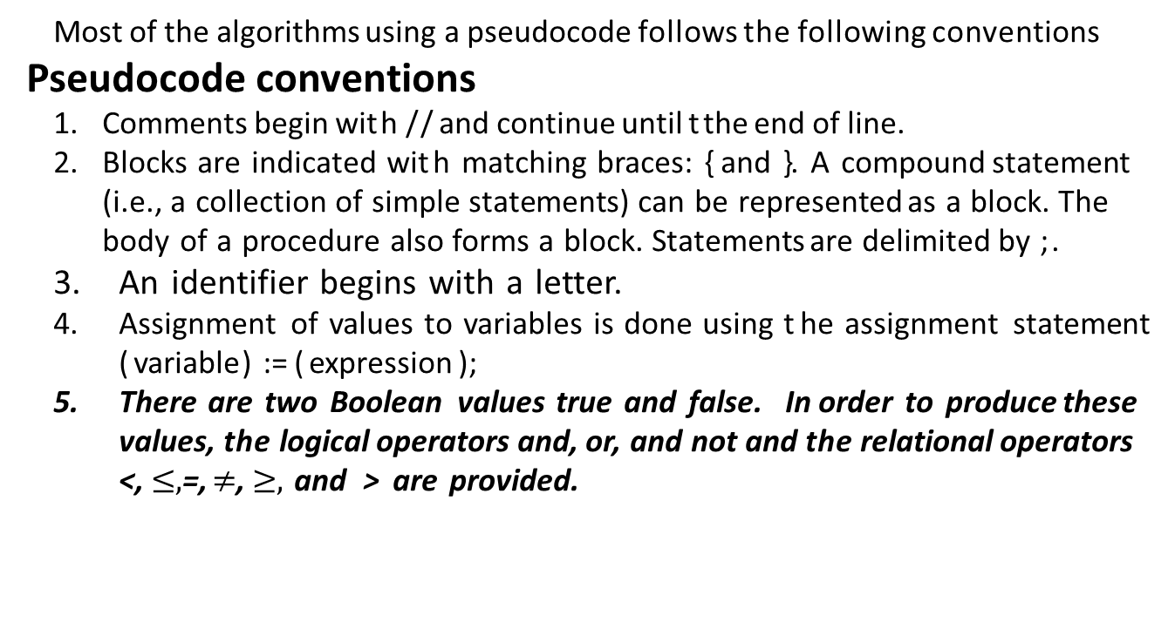
  ALGORITHM SPECIFICATION
Most of the algorithms using a pseudocode follows the following conventions
Pseudocode conventions
Comments begin wit h / / and continue until t the end of line.
Blocks are indicated wit h matching braces: { and }. A compound statement (i.e., a collection of simple statements) can be represented as a block. The body of a procedure also forms a block. Statements are delimited by ;.
An identifier begins with a letter.
Assignment of values to variables is done using t he assignment state­ment ( variable) := ( expression );
There are two Boolean values true and false. In order to produce these values, the logical operators and, or, and not and the relational operators <, $≤,$=, $≠$, $≥,$ and > are provided.

Slide 9
  ALGORITHM SPECIFICATION
Elements of multidimensional arrays are accessed using [ and ]. For example, if A is a two-dimensional array, the (i, j) th element of the array is denoted as A[i, j]. Array indices start at zero.
The following looping statements are employed: for, while, and repeat­ until. The while loop takes the following form:
  while ( condition) do
  {
  ( statement 1)
  ( statement n)
  }
As long as ( condition) is true, t he statements get executed. When ( condition) becomes false, t he loop is exited. The value of ( condition) is evaluated at the top of the loop.

Slide 10
  ALGORITHM SPECIFICATION
The general form of a for loop is
for variable:= valuel to value2 step step do
{
( statement 1)
( statement n)
}
Here valuel , value2 , and step are arithmetic expressions.

Slide 11
  ALGORITHM SPECIFICATION
A repeat-until statement is constructed as follows:
  repeat
  ( statement 1)
  ( statement n) until ( condition)
The statements are executed as long as ( condition) is false. The value of ( condition) is computed after executing t he statements.
A conditional statement has the following forms:
    if ( condition) then ( statement )
    if ( condition) then ( statement 1) else ( statement 2)
    Here ( condition) is a Boolean expression and ( statement ) , ( statement 1), and (statement 2) are arbitrary statements (simple or compound) .

Slide 12
  ALGORITHM SPECIFICATION
  We also employ the following case statement:
    case
    {
    }
    :( condition 1): ( statement 1)
    :( condition n): ( statement n)
    :else: ( statement n + 1)
Input and output are done using the instructions read and write. No format is used to specify the size of input or output quantities.

Slide 13
  ALGORITHM SPECIFICATION
There is only one type of procedure: Algorithm. An algorithm consists of a heading and a body. The heading takes the form
Algorithm Name ( (parameter list ) )
As an example, the following algorithm finds and returns the maximum of n given numbers:
1 Algorithm Max(A, n)
2 / / A is an array of size n.
3 {
4 Result := A[i];
5 for i:= 2 to n do
6 if A[i] > Result then Result := A[i];
7 return Result ;
8 }
In this algorithm (named Max) , A and n are procedure parameters and result and i are local variables.

Slide 14
  ALGORITHM SPECIFICATION –Recursive Algorithms
A recursive function is a function that is defined in terms of itself.
An algorithm is said to be recursive if the same algorithm is invoked in the body
An algorithm that calls itself is direct recursive
Algorithm A is said to be indirect recursive if it calls another algorithms which in turn calls A.
// An example of indirect recursion
void indirectRecCall1()
{
// Some code...
indirectRecCall2();
// Some code...
}
void indirectRecCall2() { // Some code...
indirectRecCall1(); // Some code... }
void directRecCall()
{
// Some code....
directRecCall();
// Some code...
}

Slide 15
  Performance Analysis
Analyzing the performance of an algorithm is an important part of its design. One of the ways to estimate the performance of an algorithm is to analyze its complexity..
Any algorithm should have three key features:
It should be correct. An algorithm won't do you much good if it doesn't give you the right answers.
A good algorithm should be understandable. The best algorithm in the world won't do you any good if it's too complicated for you to implement on a computer.
A good algorithm should be efficient. Even if an algorithm produces a correct result, it won't help you much if it takes a thousand years or if it requires 1 billion terabytes of memory.

Slide 16
  Performance Analysis
There are two possible types of analysis to quantify the complexity of an algorithm:
Space complexity analysis: Estimates the runtime memory requirements needed to execute the algorithm.
Time complexity analysis: Estimates the time the algorithm will take to run.
Space complexity analysis
Space complexity analysis estimates the amount of memory required by the algorithm to process input data.
While processing the input data, the algorithm needs to store the transient temporary data structures in memory.
The way the algorithm is designed affects the number, type, and size of these data structures.
Space complexity analysis is a must for the efficient design of algorithms. If proper space complexity analysis is not conducted while designing a particular algorithm, insufficient memory availability for the transient temporary data structures may trigger unnecessary disk swapping, which could potentially considerably affect the performance and efficiency of the algorithm.

Slide 17
  Performance Analysis
Time complexity analysis
Time complexity analysis estimates how long it will take for an algorithm to complete its assigned job based on its structure.
In contrast to space complexity, time complexity is not dependent on any hardware that the algorithm will run on.
Time complexity analysis solely depends on the structure of the algorithm itself.
The overall goal of time complexity analysis is to try to answer these important questions—will this algorithm scale? How well will this algorithm handle larger datasets?
To answer these questions, we need to determine the effect on the performance of an algorithm as the size of the data is increased and make sure that the algorithm is designed in a way that not only makes it accurate but also scales well.
The performance of an algorithm is becoming more and more important for larger datasets in today's world of "big data."

Slide 18
  Performance Analysis
Any solution to a problem requires memory to complete its required task. For any algorithm, memory is used for the following entities:
Variables be it temporary or constant.
The instruction of the program.
Memory is required for the execution that is for binary.
Space complexity is the amount of space/memory required by the algorithm to execute and produce the result.
while executing, algorithm uses memory for three reasons:
Instruction space: It is the amount of space/memory required to save the compiled version of the instruction.
Environmental Stack: This is used during the function call. If an algorithm has a function which again calls a new function, then the context (variables) of the old function is stored in the system stack and is restored once the called function returns.

Slide 19
  Performance Analysis
For example, if a function A() calls function B() inside it, then all the variables of the function A() will get stored on the system stack temporarily, while the function B() is called and executed inside the function A().
Data Space: It is the amount of space required by variables and constant.
But while computing the space complexity of an algorithm, we would consider only Data space and neglect the Instruction and Environmental Space.
Calculating the Space Complexity:
To calculate the space complexity, we need to know the amount of memory required by each different type of datatype variables. This varies depending upon the type of operating system but the method to calculate the system complexity remains the same.

Slide 20
  Performance Analysis
Example-1:
int fun()
{
int d = a + b + c;
return d;
}
In the above example, variables a, b, c, d are of integer type, hence they would be occupying 4 bytes each. The total memory required would be 16 bytes + 4 bytes for the return, making it 20 bytes.
The space required is fixed for the above example, hence it is called Constant space complexity.

Slide 21
  Performance Analysis
  int sum ( int a [], int n)
  {
  int result = 0;
  for ( int i =0; i < n; i ++)
  result = result + a[i];
  return result;
  }
Example-2:
In the above example, since it is an integer array and the size of the array is ‘n’, hence the total space occupied by array will be (n *4) bytes.
The other variables like ‘result’, ‘n’ and ‘i’ would be taking 4 bytes each. The total space would be 4n + 12. Thus, the space occupied by this algorithm is directly proportional to the size of the array that is linearly dependent on array size. Hence, space complexity is known as linear space complexity.

Slide 22
  Performance Analysis
Analysis of algorithms
The steps involved in carrying out mathematical analysis for the iterative algorithm are as follows
Measure the input size, that is the length of the input data
Measure the running time using either step count or operation count
In the case of operation count find the worst best and average case efficiencies of the algorithm.
Identify the rate of growth(increasing the input size and assessing the behavior of the algorithm)

Slide 23
  Performance Analysis
Measuring input size
Algorithm analysis is dependent on the size of the input. The input size N or n is denoted as the number of binary bits used to represent the input data. The efficiency of an algorithm is always expressed as a function of the input size.
For example, finding the determinant of a matrix of order 3x3 may be a simple task. However, if the matrix order becomes 1024x1024, the runtime of the algorithm increases.
Integer: The common practice is to use the number of bits required to store input. Input size is given as log₂N. For example N=10 takes 4 bits as a binary representation.
For matrices the order of the matrix is considered for finding the input size.
Arrays: The order of the array can be used as the input size.
Graphs: Either number of edges or number of vertices or both can be used as the input size of the graph.

Slide 24
  Performance Analysis
Measuring running time
Algorithm analysis
Step count operation count asymptotic analysis recurrence relations amortized analysis

Slide 25
  Performance Analysis
Step count:
The idea is to count the number of instructions or steps that used by a given algorithm to perform the given task.
The first step is to find steps for execution and frequency (or number of times ) of statements.
The number of steps per execution is 0 for non-executable statements and generally 1 for executable statements.
This number varies only when a function is invoked, or composite structures are processed.

Slide 26
  Performance Analysis
Example
Algorithm simple(a,b,c)
Begin
a=b+1;
c=a+2;
d=a+b;
end

Slide 27
  Performance Analysis
step counts of simple algorithm segment
Step number | Program | Steps per execution | Frequency | Total
1 | Algorithm simple(a,b,c) | 0 | - | 0
2 | Begin | 0 | - | 0
3 | a=b+1 | 1 | 1 | 1
4 | c=a+2 | 1 | 1 | 1
5 | d=a+b | 1 | 1 | 1
6 | End | 0 | - | -
 | Total |  |  | 3
It can be observed that the total is calculated by multiplying the number of steps per execution by frequency. Therefore T(n)=3

Slide 28
  Performance Analysis
Algorithm sum()
Begin
Sum=0;
For i= 1 to n do
Sum=sum+1
End for
Return sum
End

Slide 29
  Performance Analysis
Step number | Program | Steps per execution | Frequency | Total
1 | Algorithm sum() | 0 | - | 0
2 | Begin | 0 | - | 0
3 | Sum=0; | 1 | 1 | 1
4 | For i= 1 to n do | 1 | n+1 | n+1
5 | Sum=sum+1 | 1 | n | n
6 | End for | 0 | 0 | 0
7 | Return sum | 1 | 1 | 1
8 | End | 0 | - | 0
 | Total |  |  | 2n+3
The total count is obtained by multiplying the steps per execution by the frequency . It can be observed that T(n)=2n+3 is the time complexity function of the above algorithm.

Slide 30
  Performance Analysis
Disadvantage: Evaluation of time complexity using step count is easy but the disadvantage of this method is it does not dependent on operands. For example, both a=a+10 and a=a+10000000 have the same step count.
Operation count: Operation count is another way of performing algorithm analysis. The idea is to count the number of operations instead of steps for algorithm analysis. Operations can be divided into elementary (basic) and non-elementary (non-basic operations) . Commonly used basic operations are assignment, comparison, arithmetic and logical operations.
Non elementary operations involve many elementary operations. ( example soring and finding the maximum or minimum of an array).
Steps required for performing an operation count is as follows:
  Count the number of basic operations of a program and express it as a formula
  Simplify the formula
  Represent time complexity as a function of operation count.

Slide 31
  Performance Analysis
Finding operation count:
Sequence: Let us consider the following algorithm segment
Begin
S1
S2
End

Slide 32
  Performance Analysis
Let statement sq requires m operations and statement s2 requires n operations , then whole algorithm statement requires m+n operations and called addition principle.
Selection
if(condition C) then statement P else statement Q
Let statement P requires m operations and statement Q requires n operations, thus if then else statement requires max(m,n) operations. Thus, the maximum number of operations of either with the ‘if part’ or the ‘else part’ is considered as the operation count of this segment.
Repetition: There are three types of repetition. If loop executes a task n times and if the task involves m operations , then the operation count is given nxm . This is called multiplication principle.

Slide 33
  Performance Analysis
Step number | Program | Operations accounted for | Operation cost | Repetitions | Total cost
1 | Algorithm swap(a,b) | - | 0 | - | 0
2 | Begin | - | 0 | - | 0
3 | temp=a | assignment | C1 | 1 | C1
4 | a=b | assignment | C2 | 1 | C2
5 | b=temp | Assignment | C3 | 1 | C3
6 | end
T(n)= C1+C2+C3

Slide 34

  Performance Analysis
Step number | Program | Operations accounted for | Operation cost | Repetitions | Total cost
1 | Algorithm sample () | - | 0 | - | 0
2 | Begin | - | 0 | - | 0
3 | for k=1 to n do | Assignment, testing and increment | C1 | n+1 | (n+1)*c1
4 | A=a*k | Perform multiplication | C2 | n | n*c2
5 | End For
6 | End
T(n)= (n+1) *c1+n*c2=(c1+c2) n+c1 $≈$ cn

Slide 35
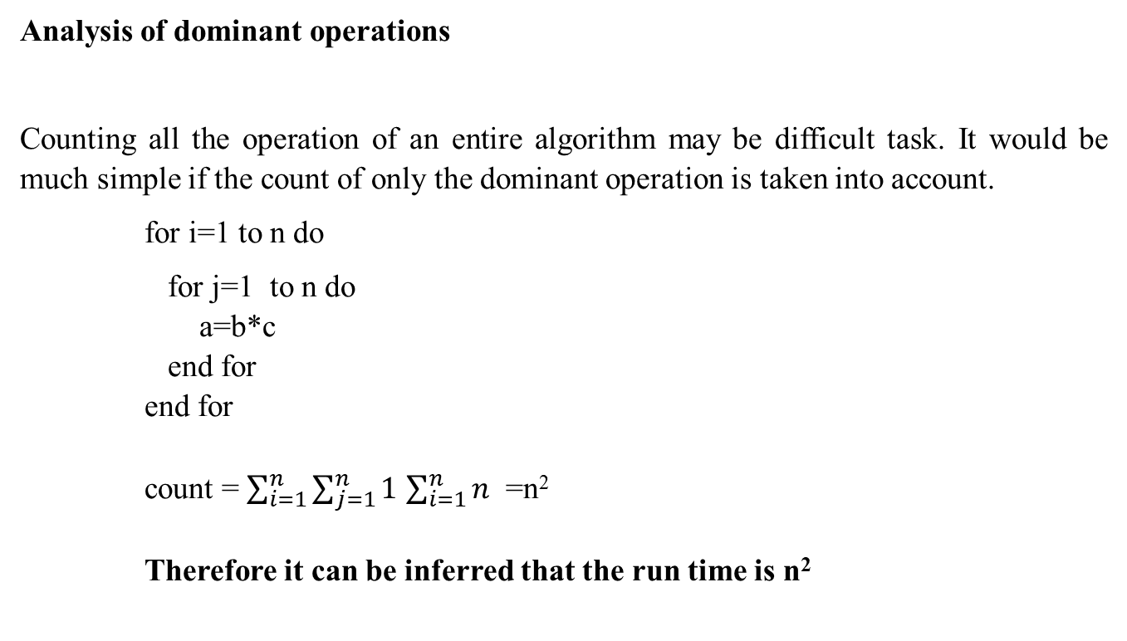
  Performance Analysis
Analysis of dominant operations
Counting all the operation of an entire algorithm may be difficult task. It would be much simple if the count of only the dominant operation is taken into account.
for i=1 to n do
for j=1 to n do
a=b*c
end for
end for
count = $\sum_{i=1}^{n}{\sum_{j=1}^{n}{1}}$ $\sum_{i=1}^{n}{n}$ =n²
Therefore it can be inferred that the run time is n²

Slide 36
  Performance Analysis
Uni-cost model: in a uniform cost model, the cost for performing an operation is assumed to be one. The cost is not dependent on the operand.
logarithm cost model: in a logarithmic cost model, the cost is dependent on the operand. If a larger integer is used, then the cost is determined as the logarithm of the size of operand multiplied by a factor C(eg clogn). This model can easily be simulated in a real word computer by scaling down the computer time with a constant.
Mathematical analysis (or a priori analysis or theoretical analysis) is performed before the algorithm is translated into a program. Thus, mathematical analysis is used to estimate time complexity in terms of step count or operation count.
Mathematical analysis is independent of any particular machine, programming language, operating systems, compiler etc.
It is applied before the algorithm is converted into a program.

Slide 37
  Performance Analysis
Empirical analysis
Empirical analysis is done after the algorithm is converted to a code. This analysis is dependent on the programming language or machine environment results of this analysis are dependent on the distribution of inputs and all machine dependencies are taken into account. Mathematical analysis is difficult for lengthy algorithms but for empirical analysis, the length of the program is immaterial.

Slide 38
Can we use loops in recursion?
Technically, you can use for and while loops within recursive functions. However, doing so often defeats the purpose of recursion, which is to break a problem down into smaller, more manageable subproblems.
Recursive functions typically rely on self-calling to solve smaller instances of the same problem until a base case is reached. Introducing loops within recursive functions can lead to unnecessary complexity and might make the code less readable.
Recursion is more intuitive and easier to code than Loop. So, you can say that recursion is better than loop constructs. But Loops have some advantages over recursion. Recursion may cause Stack Overflow if you are making too long (deep) recursive calls.

Slide 39
Can we use loops in recursion?
void swap(int *a, int *b) {
int temp = *a;
*a = *b;
*b = temp;
}
void bSort(int arr[], int n) {
// Use recursion to simulate loop iterations
if (n == 1) {
return; // Base case: array of size 1 is already sorted
}
for (int i = 0; i < n - 1; i++) {
if (arr[i] > arr[i + 1]) {
swap(&arr[i], &arr[i + 1]);
}
}
bSort(arr, n - 1); // Recursively sort the remaining n-1 elements
}

Slide 40
  For Understanding
1. O(1)
void printFirstElementOfArray(int arr[])
{
printf("First element of array = %d",arr[0]);
}
This function runs in O(1) time (or "constant time") relative to its input. The input array could be 1 item or 1,000 items, but this function would still just require one step.

Slide 41
  For Understanding
O(n)
void printAllElementOfArray(int arr[], int size)
{
for (int i = 0; i < size; i++)
{
printf("%d\n", arr[i]);
}
}
This function runs in O(n) time (or "linear time"), where n is the number of items in the array. If the array has 10 items, we have to print 10 times. If it has 1000 items, we have to print 1000 times.

Slide 42
  For Understanding
O(n²)
void printAllPossibleOrderedPairs(int arr[], int size)
{
for (int i = 0; i < size; i++)
{
for (int j = 0; j < size; j++)
{
printf("%d = %d\n", arr[i], arr[j]);
}
}
}
Here we're nesting two loops. If our array has n items, our outer loop runs n times and our inner loop runs n times for each iteration of the outer loop, giving us n² total prints. Thus, this function runs in O(n²) time (or "quadratic time"). If the array has 10 items, we have to print 100 times. If it has 1000 items, we have to print 1000000 times.

Slide 43
  For Understanding
O(2^{n})
int fibonacci(int n)
{
if (n <= 1) return num;
return fibonacci(n - 2) + fibonacci(n - 1);
}
An example of an O(2^{n}) function is the recursive calculation of Fibonacci numbers. O(2^{n}) denotes an algorithm whose growth doubles with each addition to the input data set. The growth curve of an O(2^{n}) function is exponential - starting off very shallow, then rising dynamically

Slide 44
  For Understanding
O(2^{n})
int fibonacci(int n)
{
if (n <= 1) return num;
return fibonacci(n - 2) + fibonacci(n - 1);
}
An example of an O(2^{n}) function is the recursive calculation of Fibonacci numbers. O(2^{n}) denotes an algorithm whose growth doubles with each addition to the input data set. The growth curve of an O(2^{n}) function is exponential - starting off very shallow, then rising dynamically

Slide 45
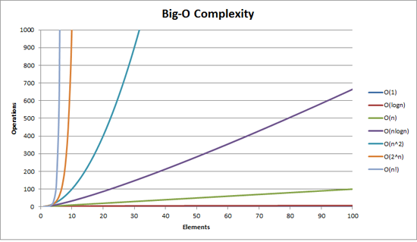
  For Understanding

Slide 46
  For Understanding
Drop the constants
When you're calculating the big O complexity of something, you just throw out the constants. Like:
void printAllItemsTwice(int arr[], int size)
{
for (int i = 0; i < size; i++)
{
printf("%d\n", arr[i]);
}
for (int i = 0; i < size; i++)
{
printf("%d\n", arr[i]);
}
}
This is O(2n), which we just call O(n).

Slide 47
  For Understanding
void printFirstItemThenFirstHalfThenSayHi100Times(int arr[], int size)
{
printf("First element of array = %d\n",arr[0]);
for (int i = 0; i < size/2; i++)
{
printf("%d\n", arr[i]);
}
for (int i = 0; i < 100; i++)
{
printf("Hi\n");
}
}
This is O(1 + n/2 + 100), which we just call O(n).
Why can we get away with this? Remember, for big O notation we're looking at what happens as n gets arbitrarily large. As n gets really big, adding 100 or dividing by 2 has a decreasingly significant effect.

Slide 48
  For Understanding
6. Drop the less significant terms
void printAllNumbersThenAllPairSums(int arr[], int size)
{
for (int i = 0; i < size; i++)
{
printf("%d\n", arr[i]);
}
for (int i = 0; i < size; i++)
{
for (int j = 0; j < size; j++)
{
printf("%d\n", arr[i] + arr[j]);
}
}
}
Here our runtime is O(n + n²), which we just call O(n²).
Similarly:
O(n³ + 50n² + 10000) is O(n³)
O((n + 30) * (n + 5)) is O(n²)

Slide 49
  For Understanding
#include<stdio.h>
#include<time.h>
void print_values(int end)
{
for (int i = 0; i < end; i++)
{
printf("%d\n", i);
}
}
int main()
{
clock_t t; t = clock(); print_values(10000);
float diff = ((float)(clock() - t)) / CLOCKS_PER_SEC ;
printf ("\n\n diff=%f \n\n", diff);
return 0;
}

Slide 50
  Step count for recursive algorithms

Slide 51
  Step count for recursive algorithms

Slide 52
  Asymptotic classes

Slide 53
  Asymptotic classes

Slide 54
  Asymptotic classes
Big O notation (O):
It is defined as upper bound and upper bound on an algorithm is the most amount of time required ( the worst-case performance). Big O notation is used to describe the asymptotic upper bound.
Mathematically, if f(n) describes the running time of an algorithm;
f(n) is O(g(n)) if there exist positive constant C and n0 such that,
0 <= f(n) <= Cg(n) for all n >= n0
n = used to give upper bound a function.

Slide 55
  Asymptotic classes
Some of the useful properties of Big-O notation analysis are as follow:
Constant Multiplication:
If f(n) = c.g(n), then O(f(n)) = O(g(n)) ; where c is a nonzero constant.
Polynomial Function:
If f(n) = a₀ + a₁.n + a₂.n² + —- + a_{m}.n^{m}, then O(f(n)) = O(n^{m}).
Summation Function:
If f(n) = f₁(n) + f₂(n) + —- + f_{m}(n) and f_{i}(n)≤f_{i+1}(n) ∀ i=1, 2, —-, m,
then O(f(n)) = O(max(f₁(n), f₂(n), —-, f_{m}(n))).
Logarithmic Function:
If f(n) = log_{a}n and g(n)=log_{b}n, then O(f(n))=O(g(n))
All log functions grow in the same manner in terms of Big-O.

Slide 56
  Asymptotic classes
2. Big Omega notation (Ω) :
It is define as lower bound and lower bound on an algorithm is the least amount of time required ( the most efficient way possible, in other words best case).
Just like O notation provide an asymptotic upper bound, Ω notation provides asymptotic lower bound.
Let f(n) define running time of an algorithm;
f(n) is said to be Ω(g (n)) if there exists positive constant C and (n0) such that
0 <= Cg(n) <= f(n) for all n >= n0 n = used to given lower bound on a function
If a function is Ω(n-square) it is automatically Ω(n) as well.

Slide 57
  Asymptotic classes
3. Big Theta notation (Θ) :
It indicates tightest bound and tightest bound is the best of all the worst-case times that the algorithm can take.
Let f(n) define running time of an algorithm.
f(n) is said to be Θ(g(n)) if f(n) is O(g(n)) and f(n) is Ω(g(n)).
Mathematically,
0 <= f(n) <= C1g(n) for n >= n0
0 <= C2g(n) <= f(n) for n >= n0
Merging both the equation, we get :
0 <= C2g(n) <= f(n) <= C1g(n) for n >= n0

Slide 58
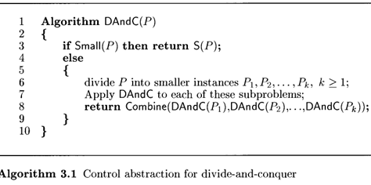
  Divide and Conquer

Slide 59

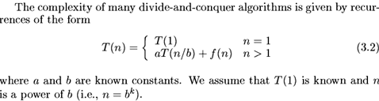
  Divide and Conquer

Slide 60
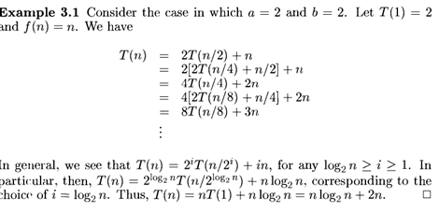
  Divide and Conquer

Slide 61
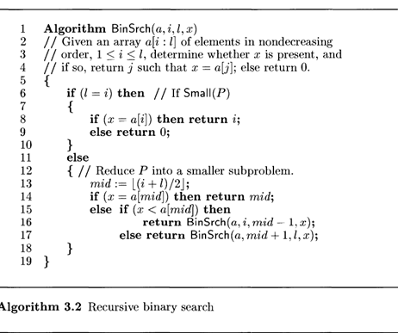
  Divide and Conquer

Slide 62
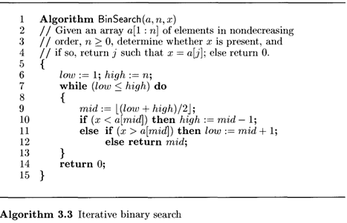
  Divide and Conquer

Slide 63
  Quick sort
Algorithm qsort(A,m,n)
{
int i,j,k,l;
if(m<n)
{
i=m;
j=n+1;
k=A[m];
do
{
do { i=i+1;} while(a[i]<=k); }
do { j=j-1;} while(a[j]>=k); }
if(i<j)
{
swap a[i] and a[j];
}
}
While(i<j)
Swap a[j] with pivot;
qsort(A,m,j-1);
qsort(A,j+1,n)
}

Slide 64
  Merge sort

Slide 65
  Merge Sort

Slide 66
  Merge Sort

Slide 67
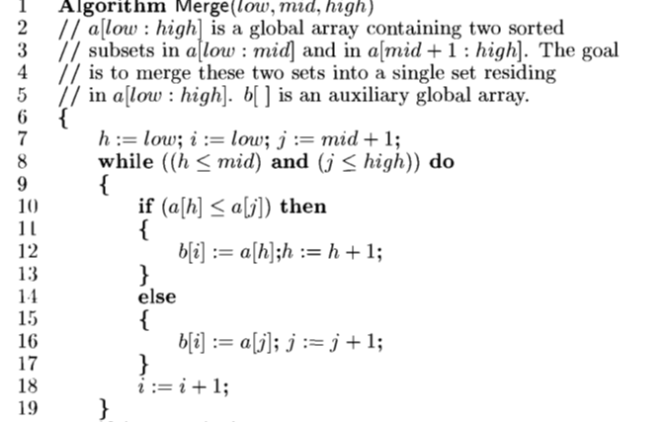
  Merge Sort

Slide 68
  Merge Sort

Slide 69
  Merge Sort

Slide 70
  Strassen's matrix multiplication

Slide 71
Master Theorem
It is the method for solving divide-and-conquer recurrence equations does not require explicit use Mathematical induction. Method for determining the asymptotic characterization of a wide variety of recurrence equations. It is used for recurrence equations of the form:

Slide 72
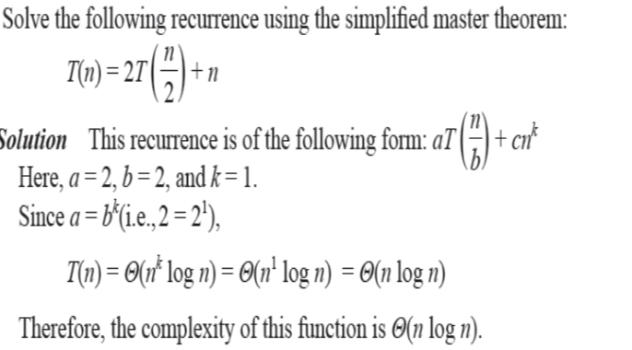
Master Theorem

Slide 73
Apriori and Apostiari Analysis
Apriori analysis means, analysis is performed prior to running it on a specific system. This analysis is a stage where a function is defined using some theoretical model. Hence, we determine the time and space complexity of an algorithm by just looking at the algorithm rather than running it on a particular system with a different memory, processor, and compiler.
Apostiari analysis of an algorithm means we perform analysis of an algorithm only after running it on a system. It directly depends on the system and changes from system to system.

Slide 74
Empirical Analysis
Empirical analysis is a crucial technique used to complement theoretical analysis by evaluating the actual performance of algorithms using real-world data and experimentation. It provides insights into how algorithms behave in practical scenarios, accounting for factors not always considered in theoretical models.
1. Validating Theoretical Analysis:
Theoretical analysis, using tools like Big O notation, predicts an algorithm's complexity (e.g., time and space complexity) based on its operations. Empirical analysis allows you to test these predictions with real-world data. By running the algorithm on various data sets of different sizes and types, you can see if the predicted complexity holds true in practice.

Slide 75
Empirical Analysis
Comparing Algorithms:
Often, multiple algorithms can solve the same problem with different theoretical complexities. Empirical analysis lets you compare the actual performance of these algorithms by running them on the same data sets and measuring their execution times and resource usage (e.g., memory). This helps you choose the most efficient algorithm for your specific needs and data characteristics.
3. Identifying Practical Limitations:
Theoretical analysis typically focuses on idealized scenarios and may not capture all real-world factors that affect performance. Empirical analysis helps you uncover these limitations. It can reveal how factors like:
Hardware architecture: Different CPU architectures or cache sizes can impact performance.
Coding implementation: Different coding styles or libraries might have varying efficiency.
Data distribution: The algorithm's performance might depend on the specific distribution of the input data (e.g., sorted vs. random).

Slide 76
Probabilistic Analysis
Probabilistic analysis is a technique used to analyze the performance of algorithms by considering the probability distribution of the input data. Unlike traditional worst-case or best-case analysis, it provides a more realistic evaluation by accounting for the randomness or uncertainty often present in real-world data.
Example: Linear Search
Probabilistic analysis allows us to consider the probability of finding the element at each position. If we assume all positions are equally likely, the average number of comparisons becomes:
Average comparisons = (1/n) + (2/n) + ... + (n/n)
= (n + n-1 + ... + 1) / n
= n (n + 1) / 2n
= (n + 1) / 2

Slide 77
Amortized Analysis
Amortized analysis is a technique used to analyze the performance of algorithms that exhibit fluctuations in their running time for individual operations. It helps us understand the average cost of an operation over a sequence of operations, even if some operations are more expensive than others.
Scenario: Imagine a data structure that initially holds 4 elements and allows adding new elements. When the array reaches its capacity, it needs to be resized to double its size to accommodate more elements.
Analysis:
Adding the first 4 elements: Each addition takes constant time (O(1)) as there's enough space. Adding the 5th element: This triggers a resize operation, which is expensive and takes O(n) time (copying existing elements to the new array). Looking at individual operations, the first 4 additions seem "cheap" at O(1), while the 5th operation is "expensive" at O(n). However, what about the average cost per operation?

Slide 78
Amortized Analysis
Amortized analysis helps us analyze the entire sequence of operations and "spread" the cost of the expensive resize operation over all additions. Average cost per addition: We consider the total time taken for all 5 additions (constant time for the first 4 + O(n) for the resize) and divide it by the number of additions (5).
This gives us an average cost of: (4 * O (1) + O(n)) / 5 ≈ O (1) + O(n/5)
Example: Dynamic stacks: Pushing and popping elements usually takes constant time, but occasionally a resize is needed, which is amortized over all operations.

Slide 79
Time and space trade-off.
It refers to the relationship between how much memory (space) an algorithm or program uses and how long it takes to run (time). Often, these two factors work in opposition:
Less Space, More Time: An algorithm can be designed to use minimal space, but this might mean it spends extra time searching through data or performing calculations.
More Space, Less Time: Conversely, an algorithm can be designed to prioritize speed by using additional space to store pre-computed information or optimized data structures.
This trade-off is a constant consideration when designing algorithms and data structures. The ideal scenario is to find an efficient balance between space and time complexity.

Slide 80
Time and space trade-off.
Here are some real-world examples of this trade-off:
Compressed vs. Uncompressed Files: Storing a file uncompressed takes up more space but allows for faster access. Compressing the file saves space but requires extra time to decompress it when needed.
Hash Tables vs. Linked Lists: Hash tables offer very fast retrieval times by using more space to store additional data for quick lookups. Linked lists use less space but may require iterating through more elements to find the desired data.

Slide 81
Recursive Tree Method
A recursion tree is useful for visualizing what happens when a recurrence is iterated. It diagrams the tree of recursive calls and the amount of work done at each call.
Recursion trees can be useful for gaining intuition about the closed form of a recurrence, but they are not a proof (and in fact it is easy to get the wrong answer with a recursion tree, as is the case with any method that includes ''...'' kinds of reasoning).

Slide 82
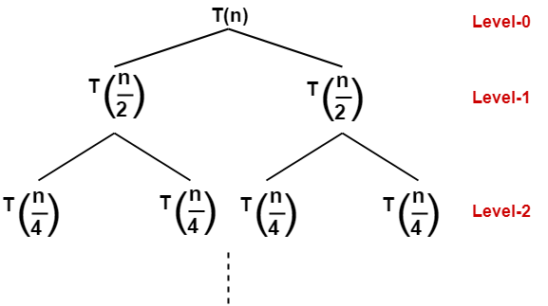
Recursive Tree Method
Solve the following recurrence relation using recursion tree method-
T(n) = 2T(n/2) + n
A problem of size n will get divided into 2 sub-problems of size n/2.
Then, each sub-problem of size n/2 will get divided into 2 sub-problems of size n/4 and so on.
At the bottom most layer, the size of sub-problems will reduce to 1.

Slide 83
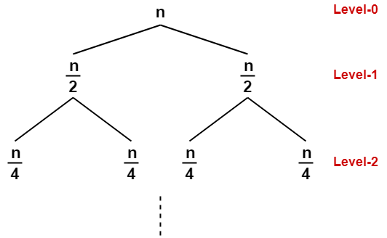
Recursive Tree Method
The given recurrence relation shows-
The cost of dividing a problem of size n into its 2 sub-problems and then combining its solution is n.
The cost of dividing a problem of size n/2 into its 2 sub-problems and then combining its solution is n/2 and so on.
This is illustrated through following recursion tree where each node represents the cost of the corresponding sub-problem-

Slide 84
Step-02:
Determine cost of each level-
Cost of level-0 = n
Cost of level-1 = n/2 + n/2 = n
Cost of level-2 = n/4 + n/4 + n/4 + n/4 = n and so on.
Step-03:
Determine total number of levels in the recursion tree-
Size of sub-problem at level-0 = n/2⁰
Size of sub-problem at level-1 = n/2¹
Size of sub-problem at level-2 = n/2²

Slide 85
Continuing in similar manner, we have-
Size of sub-problem at level-i = n/2^{i}
Suppose at level-x (last level), size of sub-problem becomes 1. Then-
n / 2^{x} = 1
2^{x} = n
Taking log on both sides, we get-
xlog2 = logn
x = log₂n
∴ Total number of levels in the recursion tree = log₂n + 1
Step-04:
Determine number of nodes in the last level-
Level-0 has 2⁰ nodes i.e. 1 node
Level-1 has 2¹ nodes i.e. 2 nodes
Level-2 has 2² nodes i.e. 4 nodes

Slide 86

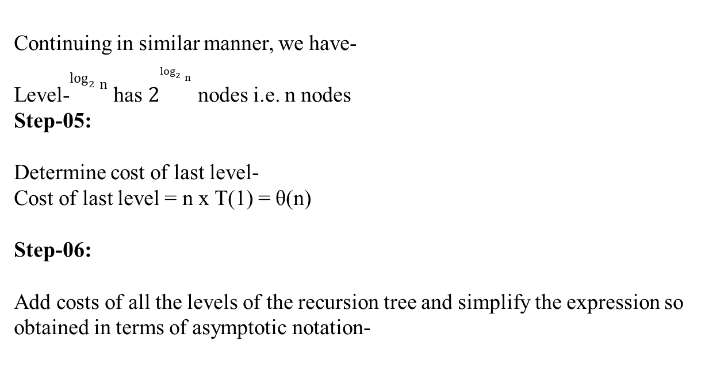
Continuing in similar manner, we have-
Level-$\log_{2}{n}$ has $2^{\log_{2}{n}}$ nodes i.e. n nodes
Step-05:
Determine cost of last level-
Cost of last level = n x T(1) = θ(n)
Step-06:
Add costs of all the levels of the recursion tree and simplify the expression so obtained in terms of asymptotic notation-
= n x log₂n + θ (n) = nlog₂n + θ (n)
= θ (nlog₂n)

Slide 87
Master Theorem
Master’s theorem is one of the many methods that are applied to calculate time complexities of algorithms.
Recurrence relations are equations that define the sequence of elements in which a term is a function of its preceding term. In algorithm analysis, the recurrence relations are usually formed when loops are present in an algorithm.
Problem Statement
Master’s theorem can only be applied on decreasing and dividing recurring functions. If the relation is not decreasing or dividing, master’s theorem must not be applied.
Master’s Theorem for Dividing Functions
Consider a relation of type −
T(n) = aT(n/b) + f(n)

Slide 88
Master Theorem
where, a >= 1 and b > 1,
n − size of the problem
a − number of sub-problems in the recursion
n/b − size of the sub problems based on the assumption that all sub-problems are of the same size.
f(n) − represents the cost of work done outside the recursion -> Θ (n^{k} logn p), where k >= 0 and p is a real number.
If the recurrence relation is in the above given form, then there are three cases in the master theorem to determine the asymptotic notations −
Case 1: if a > b^{k}, then T(n)= Θ (n^{log}_{b} ª) [log_{b} a = log a / log b]
Case 2: if a = b^{k}
If p > -1, then T(n) = Θ (n^{logb a} log^{p+1} n)
If p = -1, then T(n) = Θ (n ^{logb a} log log n)
If p < -1, then T(n) = Θ (n ^{logb a})

Slide 89
Master Theorem
Case 3: if a < b^{k},
if p >= 0, then t(n) = θ (n^{k} log^{p} n).
if p < 0, then t(n) = θ (n^{k})
Master’s Theorem for Decreasing Functions
Consider a relation of type −
T(n) = aT(n-b) + f(n)
where a >= 1 and b > 1, f(n) is asymptotically positive
Here,
n − size of the problem
a − number of sub-problems in the recursion
n-b − size of the sub problems based on the assumption that all sub-problems are of the same size.
f(n) − represents the cost of work done outside the recursion -> Θ(n^{k}), where k >= 0.

Slide 90
Master Theorem
If the recurrence relation is in the above given form, then there are three cases in the master theorem to determine the asymptotic notations −
if a = 1, T(n) = O (n^{k+1})
if a > 1, T(n) = O (a^{n/b} * n^{k})
if a < 1, T(n) = O (n^{k})
Examples
Few examples to apply master’s theorem on dividing recurrence relations −
Example 1
Consider a recurrence relation given as T(n) = 8T(n/2) + n²
In this problem, a = 8, b^{k} = 2² and f(n) = Θ (n^{k} logn p) = n², giving us k = 2 and p = 0. a = 8 > b^{k} = 2² = 4,
Hence, case 1 must be applied for this equation.
To calculate, T(n) = Θ (nlog_{b} a)
= nlog2⁸
= n (log 8 / log 2)
= n³
Therefore, T(n) = Θ(n³) is the tight bound for this equation.

Slide 91
Master Theorem
Example 2
Consider a recurrence relation given as T(n) = 4T(n/2) + n²
In this problem, a = 4, b = 2 and f(n) = Θ (n^{k} logn p) = n²,
giving us k = 2 and p = 0.
a = 4 = b^{k} = 2² = 4, p > -1
Hence, case 2(i) must be applied for this equation.
To calculate, T(n) = Θ (n^{logb a} log^{p+1} n)
= nlog₂⁴ log0+1n
= n²logn
Therefore, T(n) = Θ(n²logn) is the tight bound for this equation.

Slide 92
Master Theorem
Example 3
Consider a recurrence relation given as T(n) = 2T(n/2) + n/log n
In this problem, a = 2, b = 2 and f(n) = Θ (n^{k} logn p) = n/log n,
giving us k = 1 and p = -1.
a = 2 = b^{k} = 2¹ = 2, p = -1
Hence, case 2(ii) must be applied for this equation.
To calculate, T(n) = Θ (n logb ª log log n)
= nlog2² log logn
= n.log(logn)
Therefore, T(n) = Θ(n.log(logn)) is the tight bound for this equation.

